Slide 1
Predicting outcomes for Adjudicative appeals through Machine Learning
Michaela Webster
MSISPM Thesis Presentation
May 6, 2019

Slide 2
Previous work
Thesis by Sarah Miller (MSISPM 2017)
Database for Adjudicative Appeals cases
Includes data points for all guidelines
Primary focus on falsification
Notes:
Created a database for cases – includes information on decisions and reasons for initial denial
Hand coded cases from documents in api
Preliminary stats done on information (20,000+ records)
Focus on falsification (about ¼ of cases in data set) – only up to 2016 (still need to code 2017&2018)

Slide 3
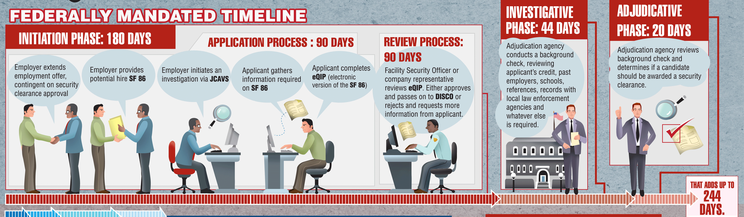
Security Clearance process
https://4d0q7u11k31p1qnkosal8q2e-wpengine.netdna-ssl.com/wp-content/uploads/2013/04/security-clearance-process-infographic.gif
Notes:
Hired -> job asks for investigation -> fill out SF86 -> reviewed -> decision made
There are 13 adjudicative guidelines:
A: Allegiance to the U.S.
B: Foreign Influence
C: Foreign Preference
D: Sexual Behavior
E: Personal Conduct
F: Financial Considerations
G: Alcohol Consumption
H: Drug Involvement
I: Psychological Conditions
J: Criminal Conduct
K: Handling Protected Information
L: Outside Activities
M: Use of Information Technology

Slide 4
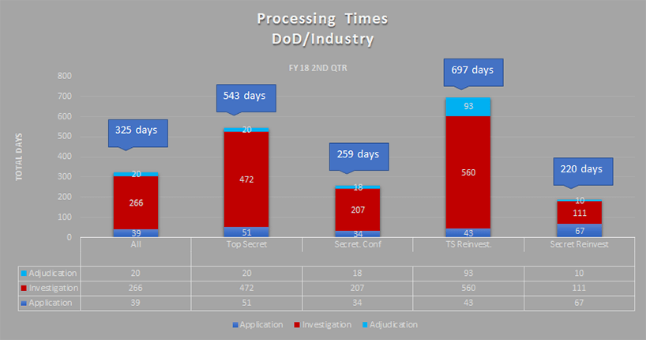
https://news.clearancejobs.com/2018/07/18/security-clearance-processing-times-continue-to-creep-upward/
Notes:
Averages > 1 year
Due to robustness of application information/investigation process
Significant backlog of applications and appeals (500,000) - https://news.clearancejobs.com/2019/04/16/latest-update-on-the-security-clearance-backlog-and-transfer-to-dod/

Slide 5
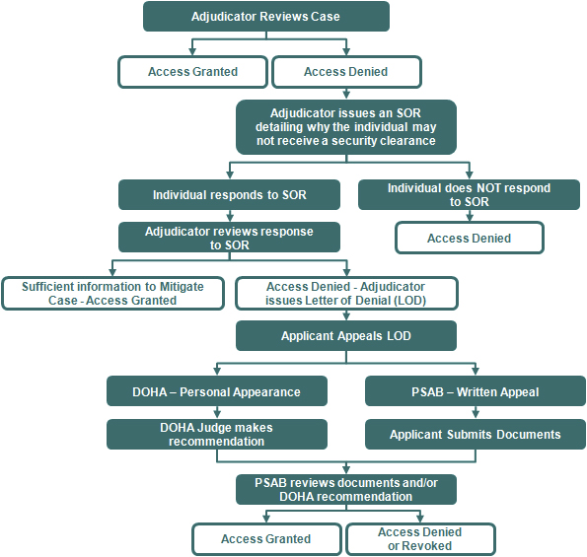
Adjudicative appeals
http://www.dami.army.pentagon.mil/site/PSAB/AdjProc.aspx
Notes:
Process:
Denied -> send notes to individual -> send back responses -> APPEAL -> reinvestigate -> decision

Slide 6
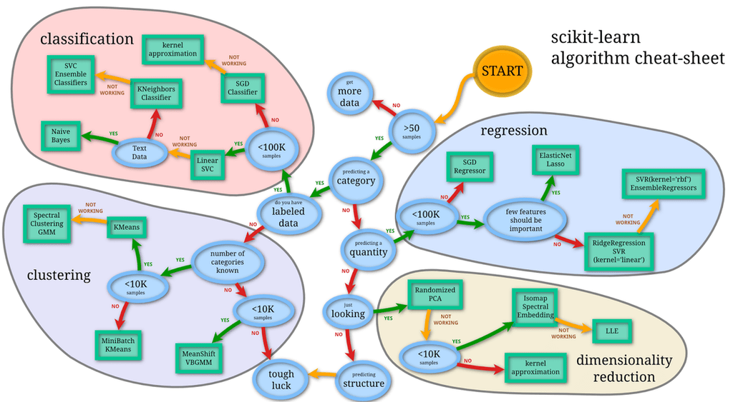
Machine learning
http://blog.kaggle.com/2015/04/15/scikit-learn-video-2-setting-up-python-for-machine-learning/
Notes:
Pros:
Helpful for making complex decisions in little time
Lots of information and apis online with support
Powerful and theory/stats driven
Cons:
Depends on dataset
Depends on input
Could be slow/costly to implement

Slide 7
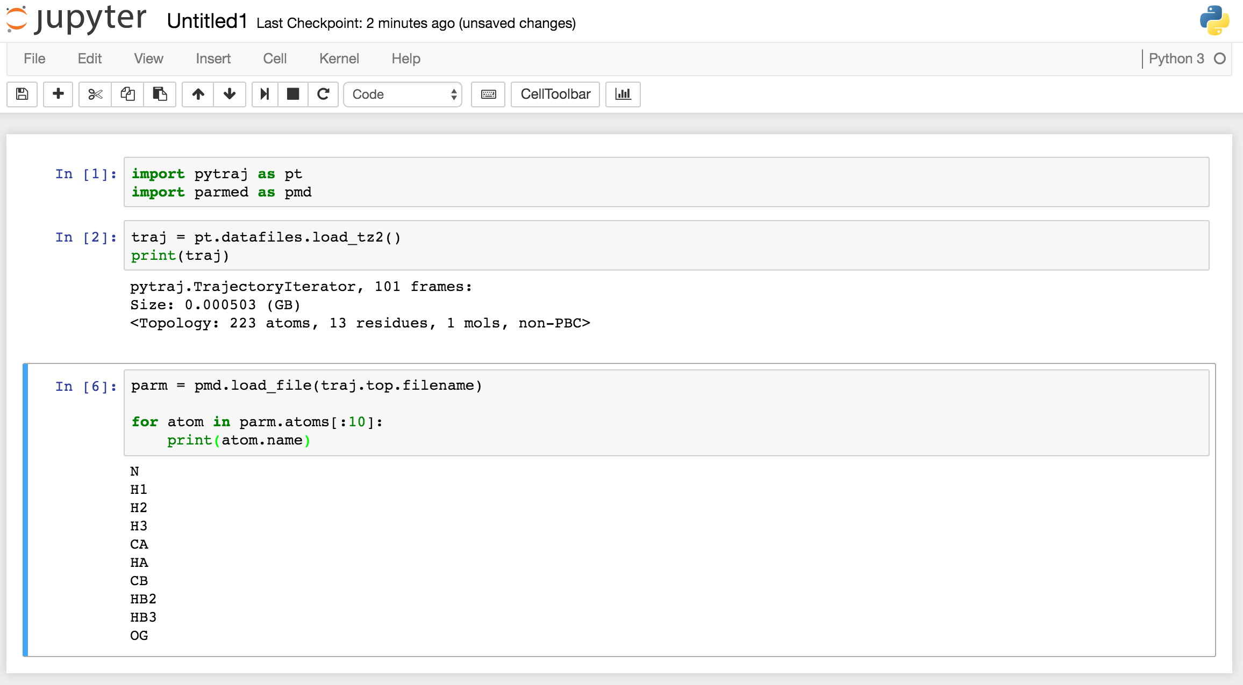
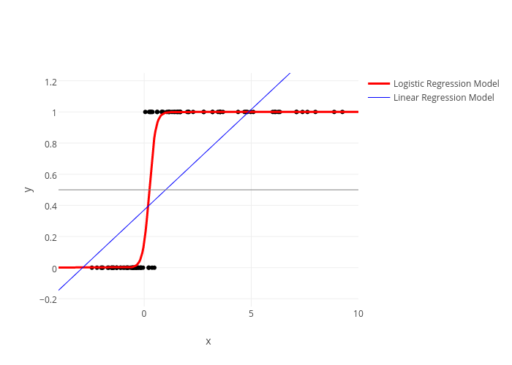
tools
https://plot.ly/scikit-learn/plot-logistic/
http://ambermd.org/tutorials/analysis/tutorial_notebooks/remote_notebook/index.html
Notes:
Jupyter notebooks:
Simple design
User friendly
Easy to debug code
Graphs
Sci-Kit Learn:
Machine learning api
Lots of documentation
Lots of functionality

Slide 8
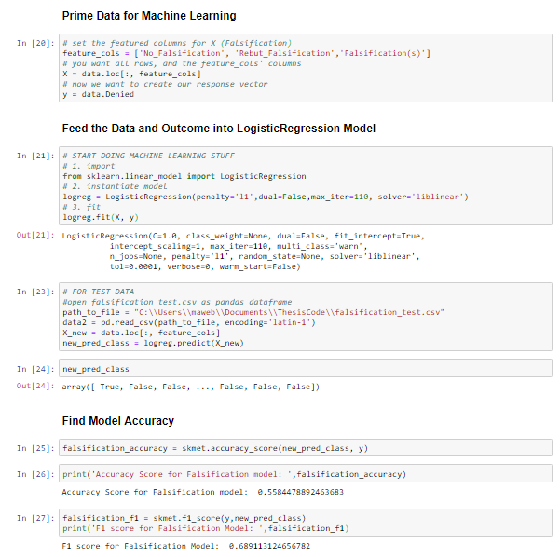
Predicting outcomes
https://github.com/mawebster9/ThesisCode/blob/master/Thesis%20-%20Alcohol.ipynb
Notes:
All notebooks follow the same flow
Prime the data for input (columns in db – true/false vals)
Feed into sci-kit learn model for log reg to build fit
Send in test data to predict the outcome based on training data
Spit out predictions
Calculate accuracy based on model
F1 score – precision and recall
Precision = # correct positive results/# of all positive results returned by classifier
Recall = # # correct positive results/# of all relevant samples (samples that should have been identified as positive)

Slide 9
Use cases and limitations
Accuracy is low due to model/data input
More data needed
Ethics behind machines vs people
Bulky to maintain/use
Notes:
Accuracy was about 50% -> essentially coin toss
Different types of models would be better suited for types of input data (text, time)
More data = better results
Machines making these decisions

Slide 10
Future work
Drugs and alcohol
More data points
Data models/input robustness
Notes:
Drugs and alcohol – use vs abuse, recency, types of drugs
Add most recent years of data – the more the better
Expand on other guidelines – not started because input not in line with log reg input (text instead of T/F)
More graphs and explanations for model outputs and data

Slide 11

https://usatodayhss.com/2018/recruiting-column-10-questions-a-college-coach-might-ask-you

